Slide 1


Uncertainty Quantification with the SimCenter quoFEM application
Francisco Galvis
Adam Zsarnóczay

Slide 2
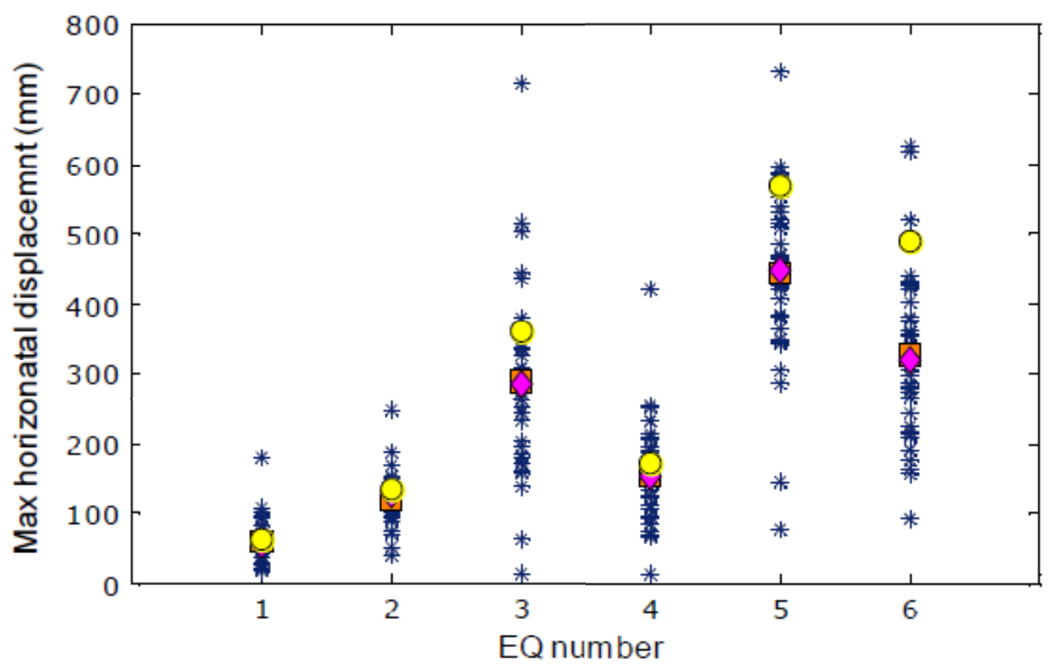
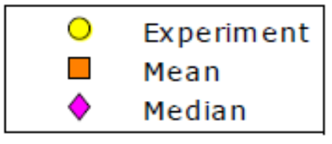
Motivation
Calibrate numerical models and quantify the uncertainty in their outputs.
Full-size bridge column tested
at the outdoor shake table at UC San Diego
Measured responses (displacements, accelerations, and reactions) compared to blind-predictions from numerical analyses
Predictions vs. Experiments
Table acceleration input history
Column lateral drift ratio history
source: PEER Report 2015/01 https://www.youtube.com/watch?v=FAeeHh_y3u0

Slide 3
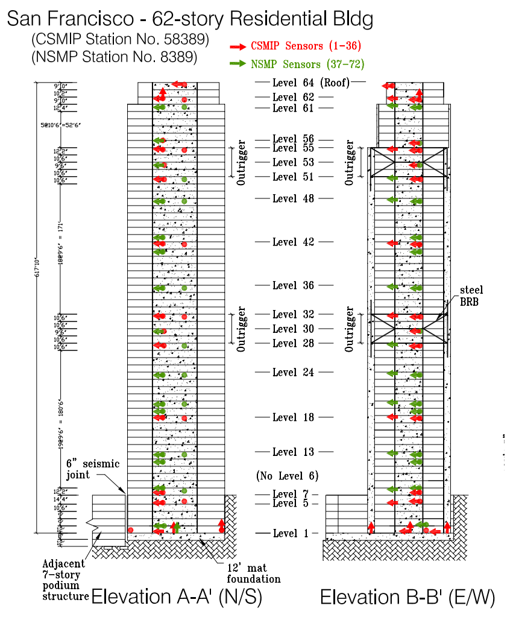
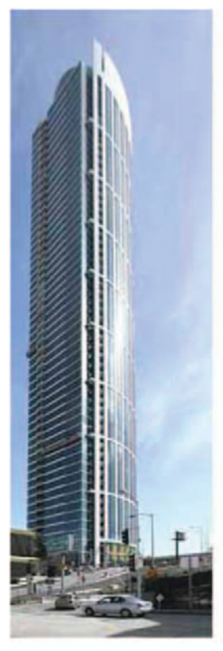
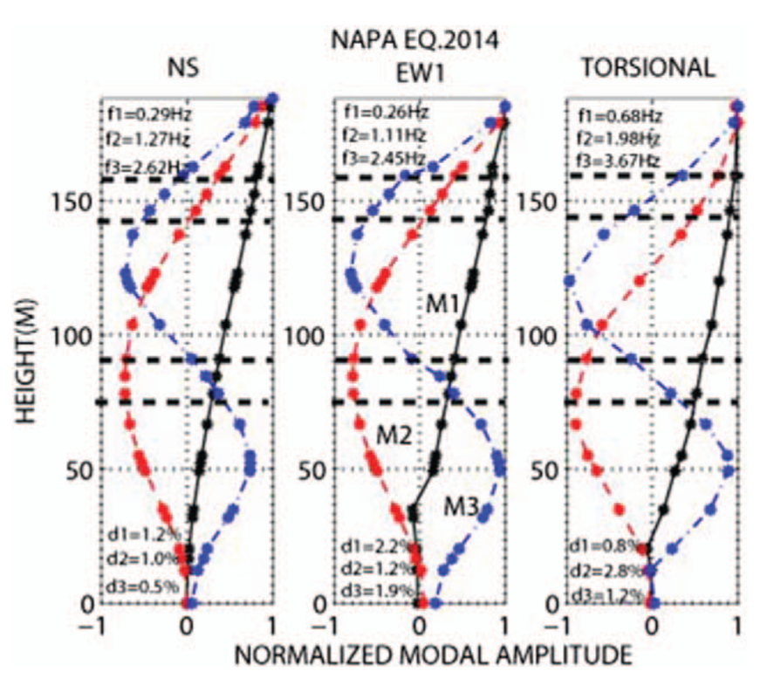
Motivation
Calibrate numerical models and quantify the uncertainty in their outputs.
Structural Health Monitoring system in One Rincon Tower records building response to earthquakes and ambient motions
System Identification is used to characterize the vibration and damping in the building
source: Celebi, Hooper, and Klemencic (2017)
doi: https://doi.org/10.1193/031616EQS041M

Slide 4






Motivation
quoFEM is a desktop application developed to
connect state-of-the-art UQ engines with computational simulation tools
UQ engines
simulation tools

Slide 5
Motivation
quoFEM is a desktop application developed to
connect state-of-the-art UQ engines with computational simulation tools
Today’s class:

Slide 6
Before we get started
Online documentation: nheri-simcenter.github.io/quoFEM-Documentation/index.html
Installation instructions: documentation: user manual/installation
Message board: simcenter-messageboard.designsafe-ci.org/smf/index.php

Slide 7
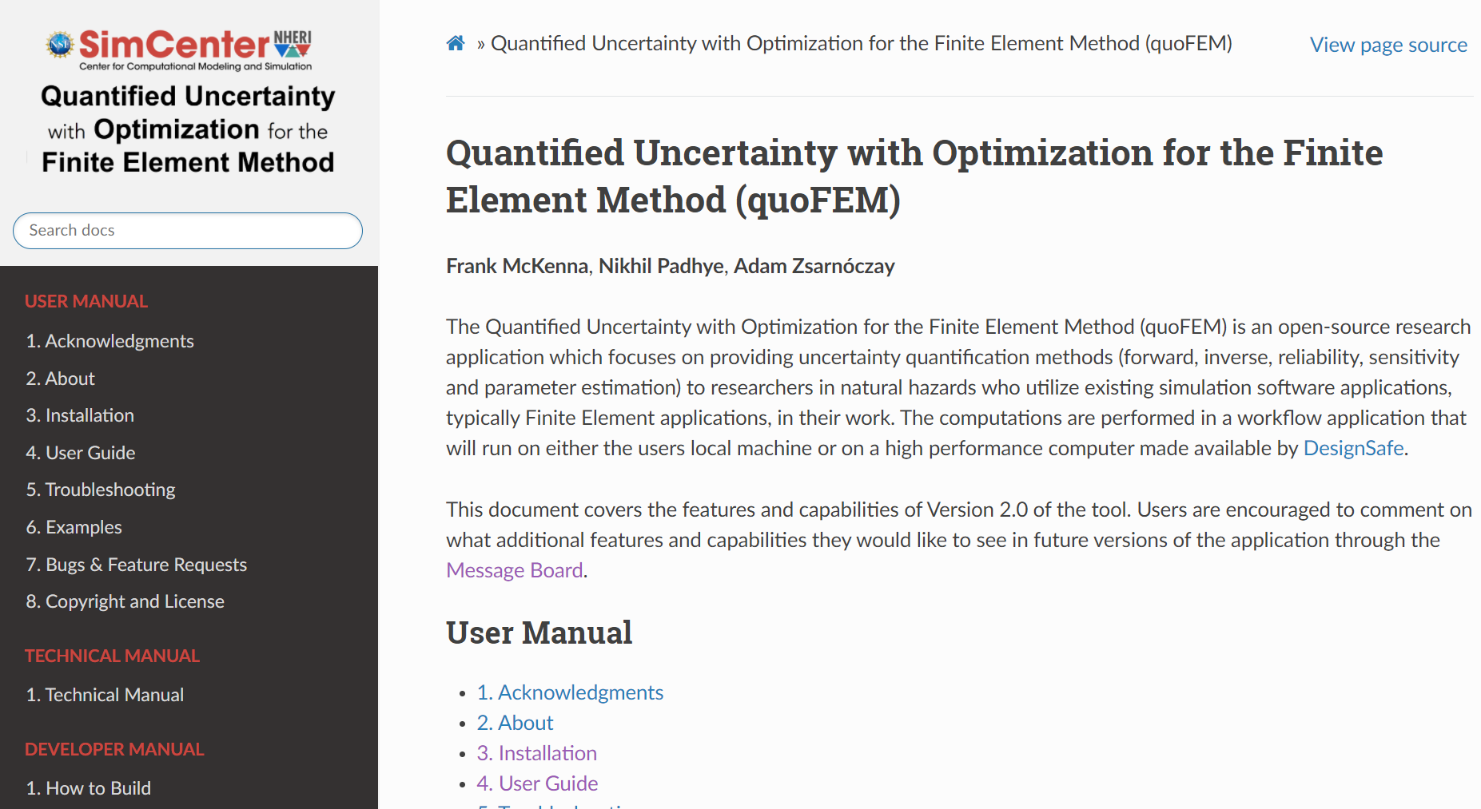
Before we get started - Installation

Slide 8
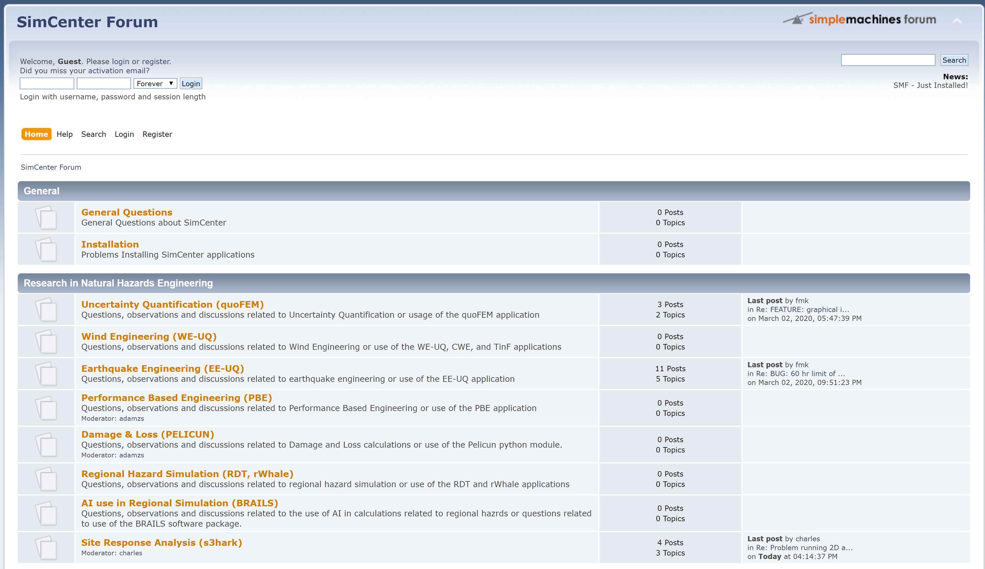
Before we get started – SimCenter Forum

Slide 9
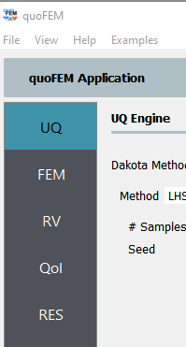
quoFEM workflow

Slide 10
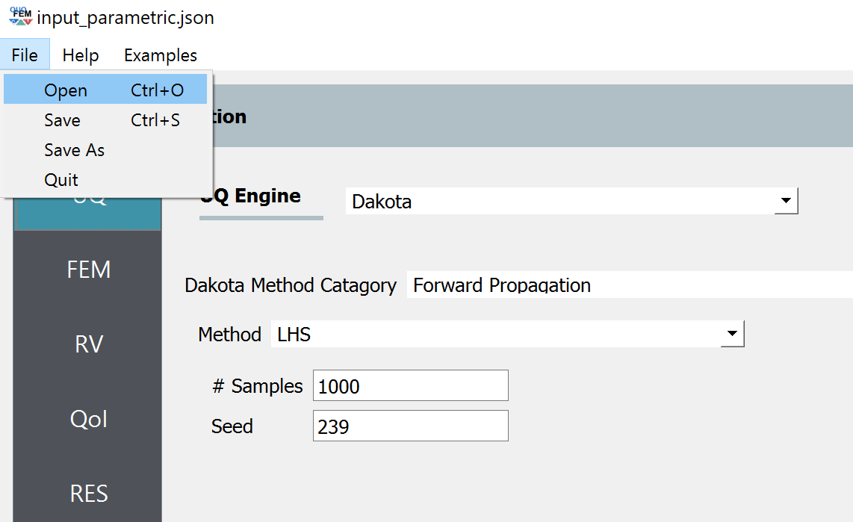
Before we get started – Loading input files

Slide 11
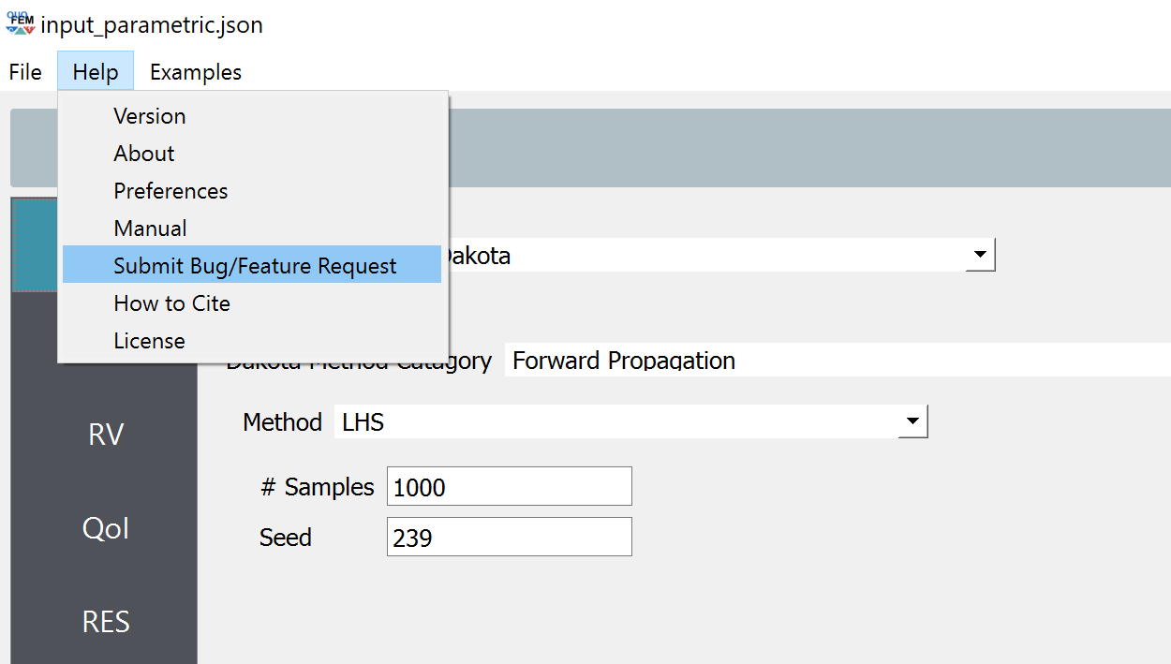
Before we get started – If something goes wrong…

Slide 12
What can we do with quoFEM?
1) Parametric Study
Explore the response surface
Formulate an objective function for calibration
2) Conventional Calibration
Optimize to minimize error;
One deterministic result
3) Bayesian Calibration
Solve the inverse problem:
distribution of params | distribution of reference results
4) Forward propagation
Propagate uncertainty in parameters to uncertainty in outputs

Slide 13
Objective functions
response quantity
(e.g., force)
model
target / reference
difference ~ error
input parameter

Slide 14
Objective functions
response quantity
(e.g., force)
model
target / reference
difference ~ error
input parameter
error measure
a.k.a. objective function
difference ~ error
input parameter

Slide 15
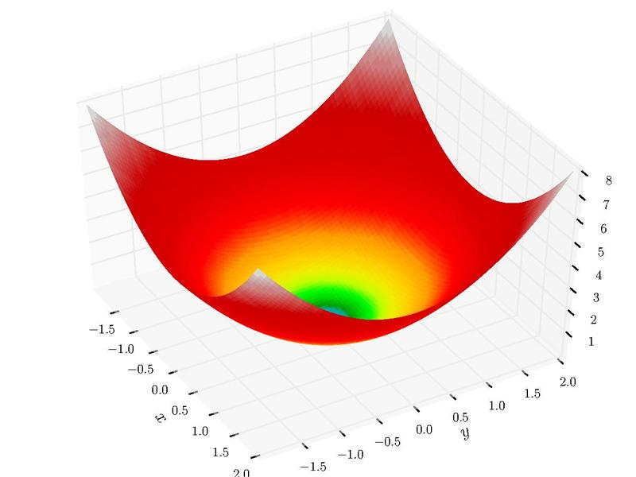

Objective functions
error measure
a.k.a. objective function
global minimum
Sphere function:
input parameter
$$f\left(x,y\right)=x^{2}+y^{2}$$
input parameter
figure source: Wikipedia

Slide 16
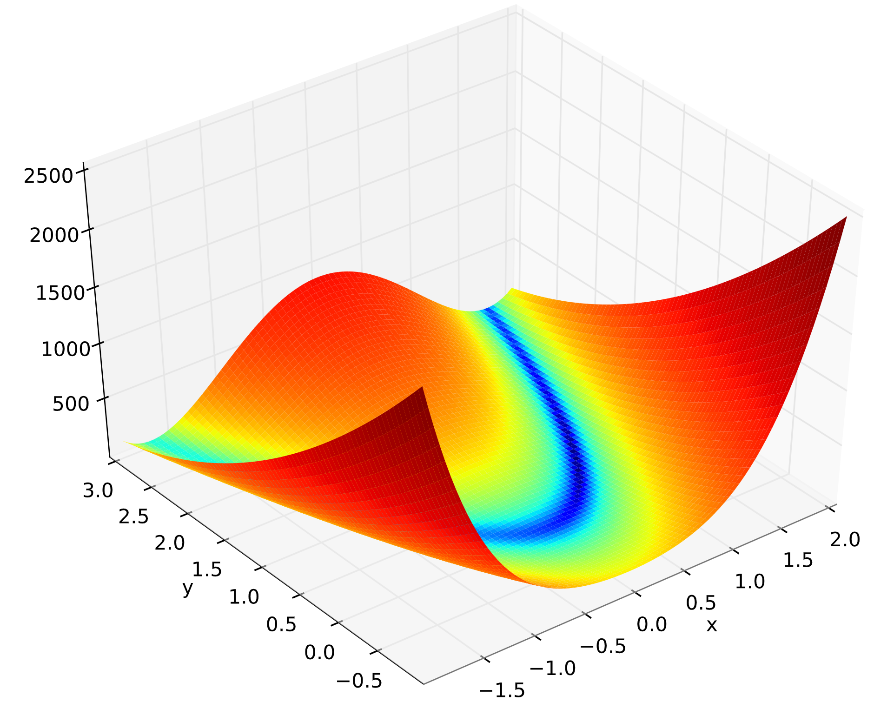
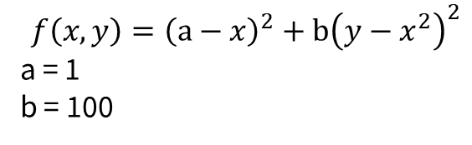
Objective functions
error measure
a.k.a. objective function
global minimum
Rosenbrock function:
input parameter
$$f\left(x,y\right)={\left(a−x\right)}^{2}+b{\left(y−x^{2}\right)}^{2}$$
a = 1
b = 100
input parameter
figure source: Wikipedia

Slide 17
Objective functions
response quantity
(e.g., force)
model
???
target / reference
difference ~ error
input parameter
error measure
a.k.a. objective function
difference ~ error
input parameter

Slide 18
Objective functions
A small mistake in the error
can lead to a large uncertainty
in the calibrated parameters
error measure
a.k.a. objective function
global minimum
f(x,y) = 0
f(x,y) = 2.25
f(x,y) = 2.25
Rosenbrock function:
input parameter
$$f\left(x,y\right)={\left(a−x\right)}^{2}+b{\left(y−x^{2}\right)}^{2}$$
a = 1
b = 100
input parameter
figure source: Wikipedia

Slide 19
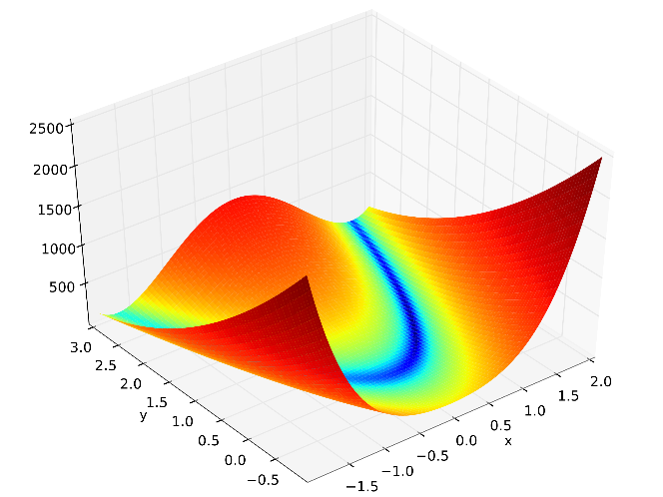
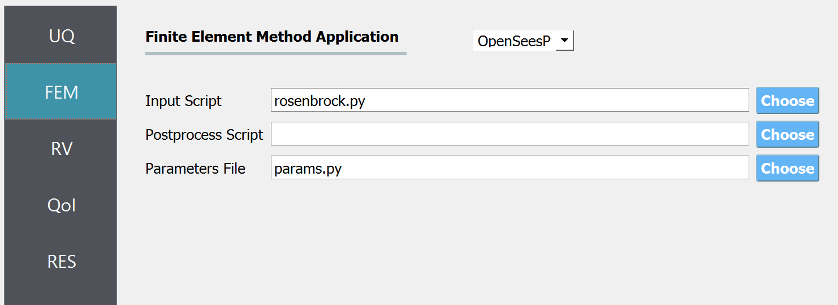
Example 0 – Rosenbrock function
source: Wikipedia
The quoFEM tool can run any Python script,
that returns one or more error measures.

Slide 20
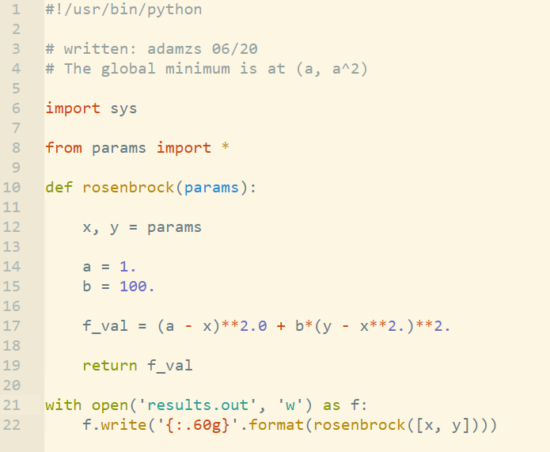
Example 0 – Rosenbrock function
source: Wikipedia
The quoFEM tool can run any Python script,
that returns one or more error measures.
rosenbrock.py

Slide 21

Example 0 – Rosenbrock function
source: Wikipedia
The quoFEM tool can run any Python script,
that returns one or more error measures.
calculation
params.py
print
output
rosenbrock.py

Slide 22
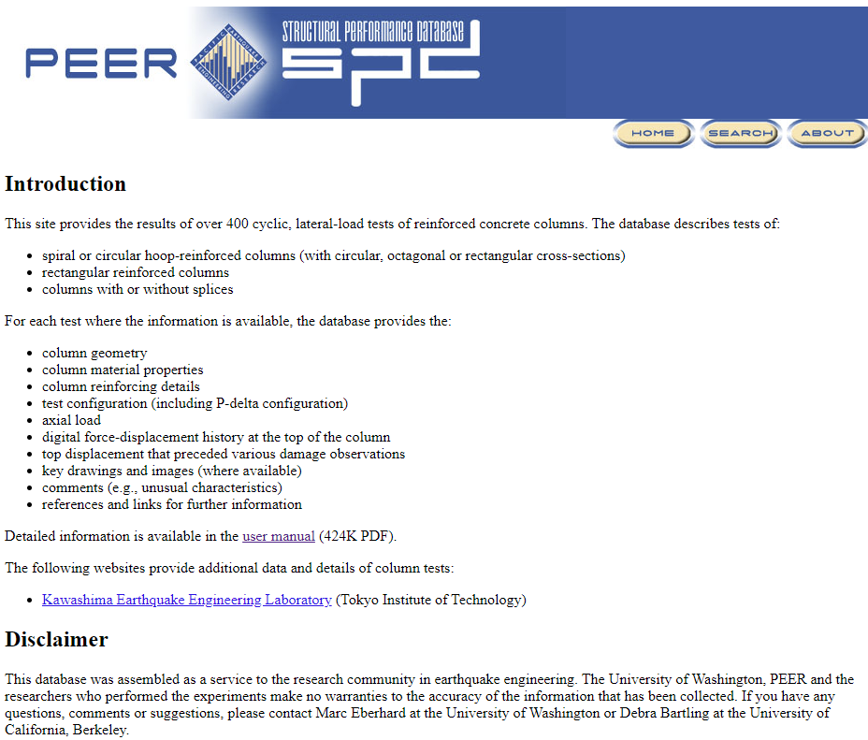
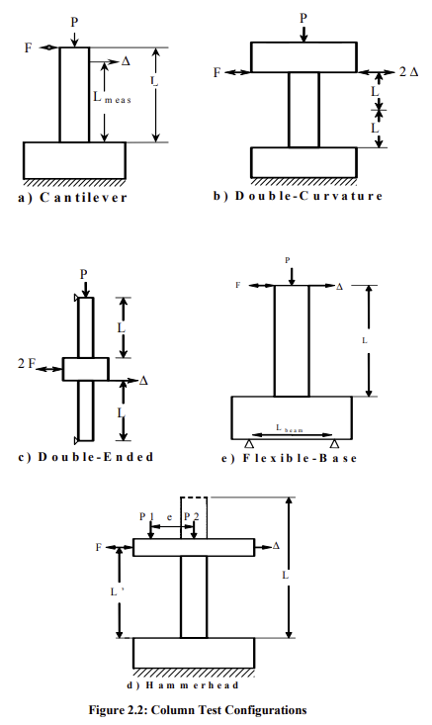
Example problem in OpenSeesPy
Parameter calibration for a concentrated plasticity column
Cantilever column model
~400 tests of RC column tests
https://nisee.berkeley.edu/spd/index.html

Slide 23
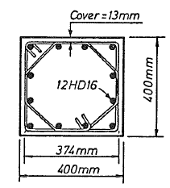
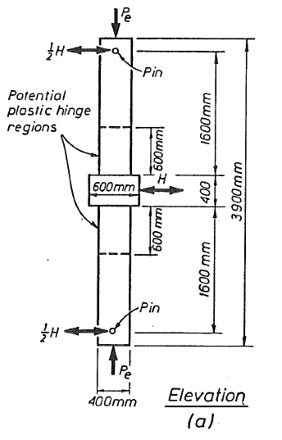
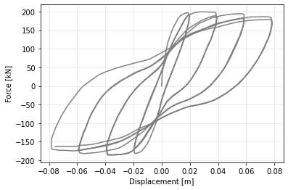
Example problem in OpenSeesPy
Parameter calibration for a concentrated plasticity column
Cantilever column model
Soesianawati, 1989

Slide 24
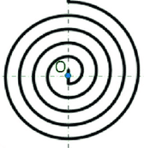
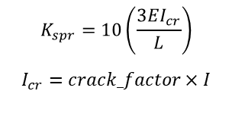
Example problem in OpenSeesPy
What are the model parameters to simulate the behavior of this column using a plastic hinge model?
Moment
Onset of degradation
Mc
E
Mp
Kspr
Mr
δc
δr
Rotation [rad]
Symmetric backbone of the rotational springs
$$K_{spr}=10\left(\frac{3EI_{cr}}{L}\right)$$
$$I_{cr}=crack_factor×I$$
Soesianawati, 1989

Slide 25
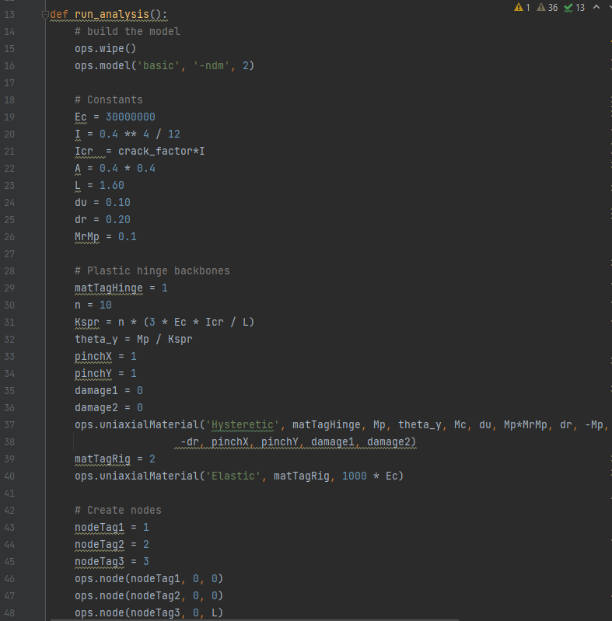
Example problem in OpenSeesPy
Calibrate elastic properties and relevant plastic hinge parameters
run_analysis.py file
provides a starting point:
Clean and open model
Define constants
Define materials
Create nodes
Assign supports
Create elements
Define lateral load
Run cyclic analysis
(takes about 2 s per iteration)
you’ll need to run
hundreds of iterations

Slide 26
What can we do with quoFEM?
source: Wikipedia
error
1) Parametric Study
Explore the response surface
Formulate an objective function for calibration
2) Conventional Calibration
Optimize to minimize error;
One deterministic result
3) Bayesian Calibration
Solve the inverse problem:
distribution of params | distribution of reference results
4) Forward propagation
Propagate uncertainty in parameters to uncertainty in outputs
input
input
error
input
input

Slide 27
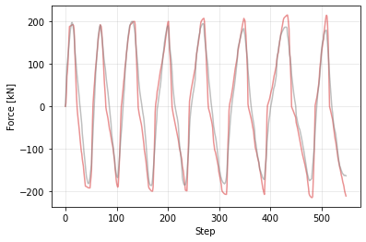
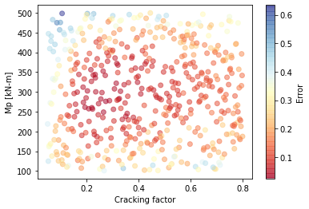
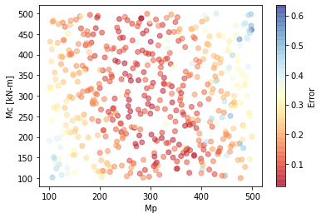

Example 1 – Parametric study
Moment
Mc
Mp
What is a reasonable range for the expected inputs?
What is the possible domain of error fitting the force history?
Kspr
$$r\left(θ\right)=y^{data}−y^{pred}\left(θ\right)$$
Objective function:
$$L\left(θ\right)=\sum_{i=1}^{N}{r_{i}{\left(θ\right)}^{2}}$$
0.10
Rotation [rad]
input
input
500 simulations
input

Slide 28
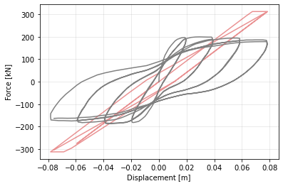
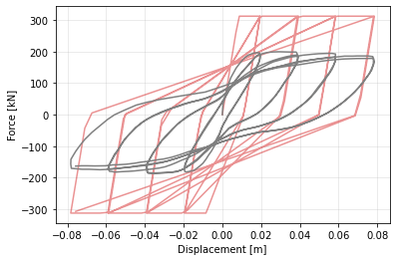
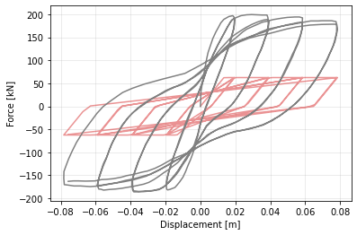
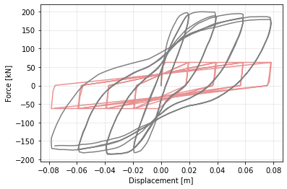
Example 1 – Parametric study

Slide 29
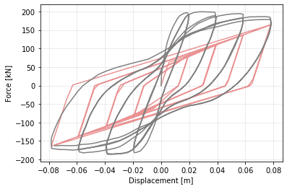
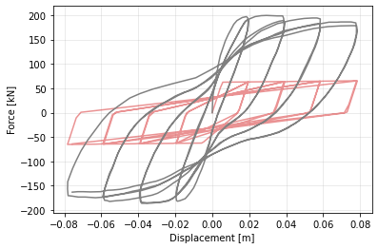
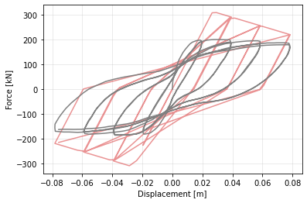
Example 1 – Parametric study

Slide 30
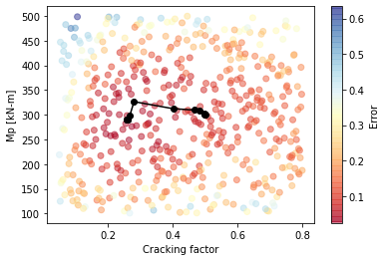
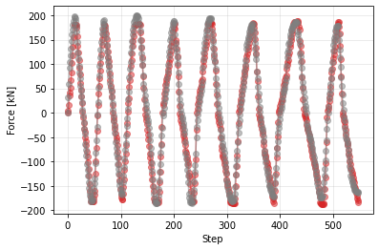
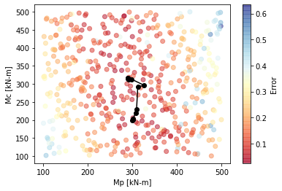
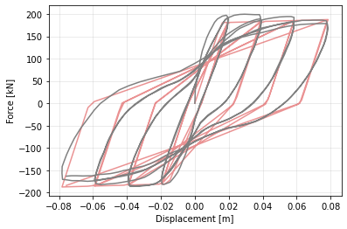
Example 2 – Optimization (Conventional Calibration)
Convergence path using deterministic calibration
12 simulations

Slide 31

Example 3 – Bayesian Calibration
What are the plausible additional parameters that could give a reasonable prediction?
from the parametric study:
Bayes’ rule:
$$p\left(θ|D\right)=\frac{p\left(D | θ\right)p\left(θ\right)}{p(D)}$$
$p\left(θ\right)$ = prior
$p\left(θ|D\right)$ = posterior
$p\left(D | θ\right)$ = likelihood function
$p(D)$ = evidence (data)

Slide 32
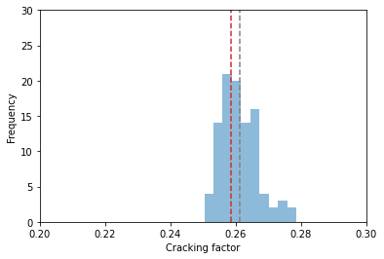
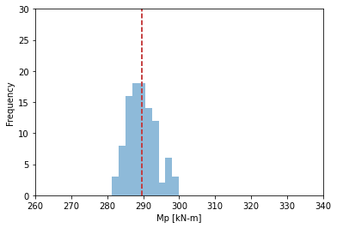
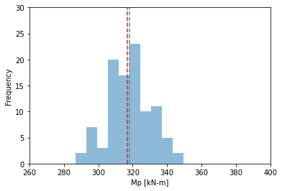
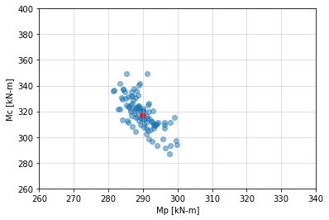
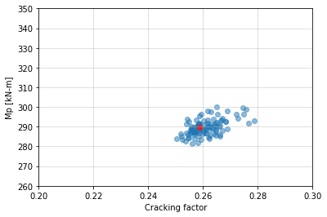
Example 3 – Bayesian Calibration
What are the plausible additional parameters that could give a reasonable prediction?
Deterministic calibration
Mean
7500 model evaluations

Slide 33
What can we do with quoFEM?
1) Parametric Study
Explore the response surface
Formulate an objective function for calibration
2) Conventional Calibration
Optimize to minimize error;
One deterministic result
3) Bayesian Calibration
Solve the inverse problem:
distribution of params | distribution of reference results
4) Forward propagation
Propagate uncertainty in parameters to uncertainty in outputs

Slide 34
Module No. 2
Repeat the steps shown in examples 1 – 3 on a different experiment from the same research project (Higher axial load).
Input files, detailed description and submission guidelines to be posted on Canvas

